Slide 1

Module 6:
Pre-bid, Bid Evaluation, Inspection and Commissioning
HP-II Workshop on Real-time Hydrological Information Systems
Mark Heggli, Meteorologist/Hydrologist
Expert Real-time Hydrology Information Systems
Innovative Hydrology, Inc.
Consultant to the World Bank

Slide 2
Examples that refer to products are intended for illustrative purposes only, and do not imply an endorsement or recommendation of any particular product

Slide 3
Items Covered In Module 6
Pre-Bid Period
Bid Evaluation
Inspection and Testing
Commissioning

Slide 4
Pre-bid Process and Meeting
The Pre-Bid process allows the bidders to ask question to clarify items within the tender
This allows for a fair process where all bidders are equally aware of the questions being posed, as well as the answers that are given
Pre-bid provides a strictly defined period were questions can be asked, and answers given, so that the procurement process continues in a timely fashion.
After the Pre-bid question period, no further questions are permitted.

Slide 5
Pre-bid Process
Bidders Prepare Questions
Pre-bid Meeting. All Questions Due
Pre-Bid Response Preparation
Pre-Bid Release of Questions and Answers to Bidders
Notes:
The Pre-bid Process Flow. This process begins with the review of the tender document, and commercial and technical details specified within the document. <c> The bidders prepare questions to clarify the technical and/or commercial details. The bidder turn these questions into the purchaser, or the agency seeking product and services. <c> Normally, all questions are due at the time of the pre-bid meeting, though there can be exceptions to extend the pre-bid question period. <c> After the pre-bid questions have been turned into the Agency, the Agency should organize the questions and group duplicate questions together, and arrive at a single list of questions. The Agency should carefully respond to these questions, offering clarification, without altering the specification. This is a time period were bidders may want to introduce inferior lower cost equipment that doesn’t meet the original specification. <c> After the Agency has formulated answers for all of the questions, the questions and answers are released to all bidders so that thy may equally benefit from the pre-bid question process.

Slide 6
Bid Evaluation
Importance of Bid Evaluation
  Assures the bidder offers qualified products
  Assures the bidder offers qualified integration
  Assures the bidder offers qualified implementation

Slide 7
Bid Evaluation Process
Collect all Bids Delivered Prior to Deadline
Develop Bid-Evaluation Review (BER)
Evaluate Bids according to Tendered Specifications
Rank Responsive Bidders by Bid Amount
Notes:
The bid evaluation process. <c> only bids delivered prior to the deadline will be considered. Bids received late will be rejected. <c> The procuring agency will collect all bid and develop a bid evaluation review, or otherwise known as a BER. <c> The bids will be evaluated according to the tendered commercial and technical specifications. There will be key specifications that will be used in the evaluation process. These key specifications must be objective in nature. If the bidder does not respond or offer equipment in any of the categories, or leaves information out that is required in the commercial process, the bidder will be deemed non-responsive. <c> all responsive bids will be organized, and then ranked according to cost.

Slide 8
Critical Requirements
Key Components
  Data Logger
  Sensors
  Telemetry
  Computer Hardware
  Computer Software
Notes:
The Specifications that are stated as a requirement in the bid document will be compared to the specifications of the products being offered by the bidder. All products must meet the specifications stated in the bid document, otherwise the bid is deemed non-responsive.

Slide 9
Critical Requirements
Key Specifications
  Equipment Identification
    Make
    Model
    Year in production
    Anticipated end of support
  Accuracy
  Resolution
  Precision/Repeatability

Slide 10
Critical Requirements
Functional Aspects
  Backup Power – Calculations & Schematic
  Grounding – Details & Schematic
  Computer Network – Details & Schematic
    Modem
    Router
    Switch/Hub
  SCADA – Operational Schematic

Slide 11
Starting Point
Equipment Offer

Slide 12
Notes:
To see if the equipment conforms to the tender specification, it would be useful to organize a list of all of the products and services that are required in the tender document. A good start for this is the Price Schedule, which should provide a list of all products. For every piece of equipment listed, the bidder must provide the make/model of the equipment being offered, along with a data sheet provided by the manufacturer that indicates the specification of the equipment being offered.

Slide 13
Item # | Goods | Offer Make/Model | Years in Production | Anticipated End of Support
1. | Hand Held Devices for Communication with Data Loggers as specified in Section 3.1 of the Technical Specifications | TDS Ranger w/8GB Flash Storage, 256 MB of RAM (Brochure Attached)
2. | Rugged Notebook Computers as specified in Section 3.2 of the Technical Specifications | GETAC A790, Windows 7 Professional, Intel Core Duo Processor 1.66 GHz, 4 GB DDRS RAM, SATA HDD 320GB, (Brochure Attached)
3. | Water Level (Bubbler) as specified in Section 3.5 of the Technical Specifications | Design Analysis H-3553 Bubbler/Pressure Sensor (Brochure Attached)
Bidder states equipment that they believe meets the specification. It is up to you to check to make sure this equipment meets specification. If it is not clear, then it is not responsive. You can use data sheets and resources on the internet to confirm whether the offer meets specification.
Notes:
This is an example of an offer by a the bidder to satisfy the requirement for products indicated in the GOODS column. The bidder should provide enough information to complete this evaluation and include the Equipment Manufacturer, Make, and Model being offered. <c> <c> <c> pause <c> Here, the bidder has offered equipment that they believe meets the specification. This does not mean that it actually does meet the specification. If the Offer Make/Model is not clear or left blank, then the bid is deemed to be non-responsive. If the Bidder did not include the data sheets which describes the specifications of the equipment being offered, then you can either request these data sheets, or look the product up the Internet, using the Product Manufacturer, Make, and Model to perform the search.

Slide 14
Common Problems with Bids
The Bid Offer is not Clear
  Make/Model not indicated
Self–certification is incorrect
  Equipment must be “easy to use”
Offered Equipment Does Not Meet Specs
Offered Equipment are not represented correctly
  Accuracy
  Resolution
  Precision/Repeatability
Notes:
Common Problems with Bids. The following is summary of common problems with bids received on various HP-2 projects. <c> A common problem is the Offer is not clear. <c> Often, the Bidders leave out the name of the manufacturer, the make, and model number of a product. It is impossible to evaluate a bid without the specifications of the equipment being offered. This makes the entire bid non-responsive. <c> Often, self-certification (a certification based on the opinion of the bidder) is incorrect. <c> For instance, if you specify that the equipment must be easy to use, the bidder may think their equipment is easy to use. I can assure you that every supplier thinks their equipment is the best and easy to use. This is why I don’t like subjective specifications such as “equipment being easy to use”. <c> Another common problem is the bid offer fails to meet specification, even though the bidder thinks it does. If the evaluation process is not thorough, then equipment that does not meet specification may be inadvertently accepted. This can reduce the effectiveness of your new HIS. <c> Another troubling problem with bids is that offered equipment is not represented correctly, which is why factory issued equipment specifications must be reviewed. Misrepresented product offerings need to be identified. Specifications commonly misrepresented can include instances where <c> Stated accuracy is incorrect. <c> stated resolution is incorrect <c> stated precision and repeatability is incorrect

Slide 15
Evaluating Bids
Bidders are to supply data sheets on all hardware
All responses indicating compliance by the bidder are to be confirmed by the data sheets.
Bidder can add manufacturers letter indicating compliance by the manufacturer
Bid Evaluation Team can use resources found on the Internet, such as Cut Sheets from the Manufacturers Web Site to assure qualification of Offer.

Slide 16
Why Confirm Specifications of Equipment Offer?
Equipment may actually not meet specification, even though Supplier states it does
Supplier can be misinformed
Supplier can be misleading
Supplier may not completely understand the specification

Slide 17
Case 1: Water Level Measurement Equipment

Slide 18
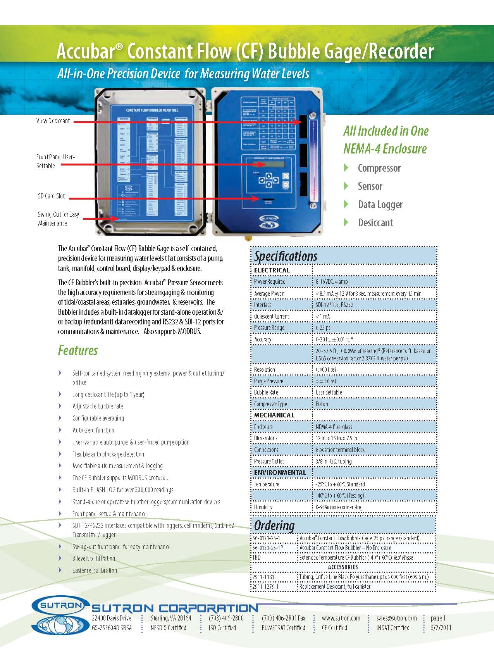
Does Not Meet Specification
X
Tender Specification
Equipment Specification
Notes:
<c> In this example we have a tender specification that states <c> an air drying system must operate for a period of two years without maintenance. <c> In this case we have a data sheet (also called a cut sheet, from the manufacturer of the equipment being offered. <c> The data sheet under features <c> <c> <c> <c> indicates that the desiccant system (air drying system) lasts for one year. <c>This means that the equipment <c> does not meet specification., even though the equipment was offered and the bidder/supplier thought the equipment did meet specification.

Slide 19




Bid Evaluation Review Example
Technical Specification
As per BD of RTDAS clause 5 Technical Spec | Bidder A | Bidder B | Bidder C
 | HS, HS- 40 | YSI, H-3553 | Sutron, Accubar Part no. 56-0133-30-1
Range of bubbler and pressure transducer shall be 30 psi. In the case that the range of water levels is greater than 20 m, an orifice manifold system with 5 m of orifice line overlap will be used to cover the entire range of water level with a single sensor . The manifold system does not need to be automated. | > 30 psi As per brochure: operation : Upto 30 m of head with 200 m of river line ( orifice )and 300 m of river line (GCO) | Custom calibration ranges available of bubbler and transducer shall be of 5-100 psi
Maintenance free operation (no desiccant replacement) for up to two years.
0.02% FSO or better | Accuracy .02 % FSO | less than or equal to 0.02 % FSO
Anodized pipe or similar material, orifice line and orifice cap will be supplied by the bidder | Orifice line and cap will be supplied by Bidder | complied
✓
Notes:
This is an example of a Bid Evaluation Review. The first column to the left indicates the technical specification as taken from the Tender. The next three columns are the bidder response as extracted from the bids. <c> The second column from the left indicates the products being offered by Bidder A. As we scan down the column, we notice that the row indicating whether the product being offered meets the requirement for maintenance free operation (no desiccant replacement) for up to two years, is in fact left blank. <c> it is not clear whether Bidder A meets this requirement, <c> and thus the Bid becomes non-responsive. The Bid Evaluation Team should review the data sheet from the manufacturers web site to check to make sure the required specification is met. They would find out that the equipment being offered actually meets the specification. <c> pause <c> The next column to the right is the evaluation for bidder B. Again, under maintenance free operation, <c> a two year warranty is mentioned. <c> In this case, upon inspecting the data sheet for the product, it is determined that the two year warranty, was an equipment warranty and not an indication of maintenance free operation. <c> in the next column, the evaluation for Bidder C is provided. In this case the product evaluation reveals that several fields are left blank <c> <c> <c> <c> and in one case states that the product complies, when the product actually does not comply. <c> <c> Other product specifications are not given, indicating that this bidder is non-responsive. As previously mentioned, the BER Team can inspect data sheets to see if the equipment meets specification.

Slide 20
Case 2: Computer Server Hardware

Slide 21
Specifications
Item | Technical specifications
PC Specifications | CPU and Memory - Pentium IV 3.0 GHz minimum or greater if required by Data Management Software Memory – 4 GB or greater if required by Data Management Software. The RAM shall be provided that fully meets data collection and processing software requirements utilizing a maximum of half the RAM. If the RAM needed to meet this specification requires a 64-bit processor then the software shall be compatible with a 64-bit processor. Hard Disk - Hard disk size capable of storing 10 years’ worth of data in addition to all software components or 1 TB, whichever is greater. Hard disk shall include at a minimum RAID 1 technology, which means the disk space will be effectively doubled. Monitor - A minimum of three computer screens that can be used to display screens from data collection and data processing processes. These screens will be a minimum of 21 inches and shall incorporate Flat Screen technology. Computer hardware will have the proper interface to use a minimum of four screens. Computer Form Factor - Rack mount. Please include computer rack with offer to house computer(s) data receivers, network devices as required by the DAS. The rack space available shall be twice that which is actually required for the equipment that is being offered. Operating systems - Windows Server 2008
Technical Specification Clearly States Rack Mount
Notes:
This table reflects the specification as provided in the tender. <c> The Specification reads (Read Specification), so <c> the technical specification clearly states the requirement for a rack mount computer. On the following slide we will see what the bidder has offered which is required to meet this specification.

Slide 22
X
Item | Required Tech. Spec. as per Bid Document | Firm A | Firm B | Firm C
Data Management Computer and Software |  | HP HP probook 6450b notebook HP probook6550b notebook CP – 811 | Aquarius Time Series Data Management Software, Aquarius Server CP 535 | HP (Computer)
PC Specifications | Hard Disk - Hard disk size capable of storing 10 years’ worth of data in addition to all software components or 1 TB, whichever is greater. Hard disk shall include at a minimum RAID 1 technology, which means the disk space will be effectively doubled. | Yes | Confirmed | Upto 28 TB internal storage Max Number of Hard Drives 25 and specifications given along
 | Monitor - A minimum of three computer screens that can be used to display screens from data collection and data processing processes. These screens will be a minimum of 21 inches and shall incorporate Flat Screen technology. Computer hardware will have the proper interface to use a minimum of four screens. | Yes | Confirmed | 3 Monitor will be supplied with the server to display data collection and data processing process. The screen will be Flat Screen 21 inches. Server will have option to interface 4 screens
 | Computer Form Factor - Rack mount. Please include computer rack with offer to house computer(s) data receivers, network devices as required by the DAS. The rack space available shall be twice that which is actually required for the equipment that is being offered. | Yes | Confirmed | A rack as per tender requirement will be supplied.
 | Operating systems - Windows Server 2008 | Yes | Confirmed | Server will be loaded with Windows server 2008.
Notebook Computer Specified, Supplier also States it is “rack mount”
This is software, not hardware
Non-responsive, no make/model
Notes:
<c> This is our bid evaluation from showing the three bid offers in the three rightmost columns. <c> The specification states that the computer form factor must be rack mount computer system. <c> however, bidder A offers a notebook computer system, and not a rackmount. <c> <c> <c> The evaluation then indicates <c> that this equipment meets the specification,<c> which it clearly does not. <c> Bidder B offers Software instead of providing a manufacturer/make/model for the computer hardware. <c> pause <c> Bidder C offers an HP Computer, but does not provide the computer manufacturer, nor the make and model of the hardware. <c> this makes this bidder non responsive, and in fact <c> all three bidders appear to be non-responsive. <c>

Slide 23
Equipment Delivery & Inspection

Slide 24
Record
Record all materials delivered
  Date of Delivery
  Type
  Make
  Model
  Serial Number
  Condition of Delivery
  Date of Acceptance
Verify that all materials received is the same submitted on the bid
Delivery Date | Type | Make | Model | Serial # | Condition | Acceptance Date
7/15/2012 | Bubbler | Sutron | 56-0134 | 14367 | Good | 7/21/12
7/15/2012 | Bubbler | Sutron | 55-0134 | 14368 | DOA | 7/21/12
7/15/2012 | Rain Gauge | Hydrological Services | TB-3 | 206788 | Damaged | 7/21/12
7/15/2012 | Rain Gauge | Hydrological Services | TB-3 | 206789 | Good | 7/21/12
7/15/2012 | Data Logger | Design Analysis | H-5000 | 7645 | Good | 7/21/12
7/17/12 | Submersible Pressure Transducer | Hach Hydromet | ecoLog 500 | 31644 | Good | 7/21/12
7/17/2012 | Computer | Dell | Latitude D630 | 1115321 | Good | 7/21/12
7/18/2012 | Solar Panel | BP | SX330 | 798743 | Good | 7/25/12
7/18/12 | Solar Regulator | MorningStar | SS-10 | 34521 | Good | 7/25/12
Notes:
Upon Equipment Delivery, the procuring agency must <c> record all materials delivered. <c> The date of delivery must be recorded, along with the product being delivered <c>→, the <c> make, <c> the model, <c> the serial number <c> the condition of delivery <c> <c> <c> and <c> the date the equipment was accepted. <c> You should verify that all materials received is the same make/model that was offered in the bid document.

Slide 25
Verify
Verify that all materials delivered are what was ordered
  Compare Bid Documents to Record of Materials Delivered

Slide 26
Database
Enter all information in data base designed for maintenance of equipment and Asset Tracking
  Vaisala Met Man®
  OneRain Contrail® Inventory
  Sutron X-Connect®
  User Written Data Base
Database capabilities
  Location
    Site Number
    Warehouse
    Factory
  Maintenance tracking
Notes:
The procuring agency should have a database where <c> all equipment received is recorded in the database. This is also quite useful in asset tracking. There are various software solutions to help you with this, these include <c> Vaisala Met Man <c> OneRain Contrail Inventory <c> Sutron X-Connect, or <c> simply a user developed data base in Microsoft Access. <c> This database will have several useful capabilities, for instance, <c> the equipment location will be able to be tracked as to which <c> field site, or if the equipment is in a <c> warehouse as spare inventory, or possibly <c> back at the factory for repair. <c> This database can also be used to track all maintenance activities, and actions taken at each of the remote sites.

Slide 27
Sample Inspection
Data Logger
Sensor
Solar Panels
Solar Charger
Enclosure
Notes:
Sample Inspection. You may not have time to thoroughly inspect each piece of equipment upon arrival, though it is important to perform an inspection of at least on make/model of each of the equipment being provided by the bidder/supplier. Inspection should include <c> Data Loggers <c> Sensors <c> Solar Panels <c> Solar Chargers, <c> Enclosures at a minimum

Slide 28
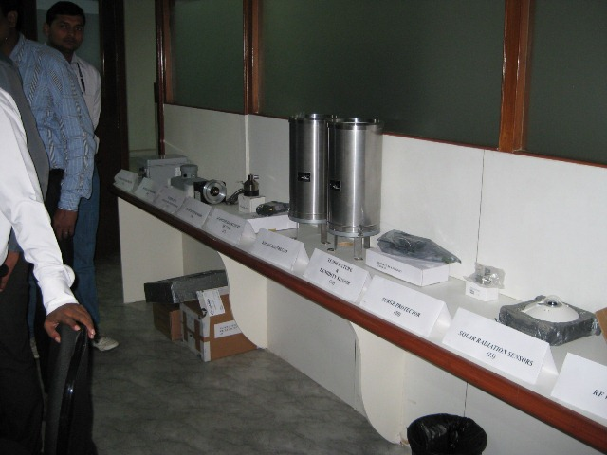
Model Inspection (Physical Inspection)
Supplier presents equipment for inspection
One of each piece of equipment displayed for inspection
Make/Model number confirmed to match offer
Notes:
Here is an example of the inspection of equipment. <c> The Bidder/Supplier has facilitated the inspection in this example, <c> where one piece of equipment of each make/model are presented for inspection. <c> Make/model are confirmed to match the make/model of the equipment offer. This is also referred to as a “physical inspection”.

Slide 29
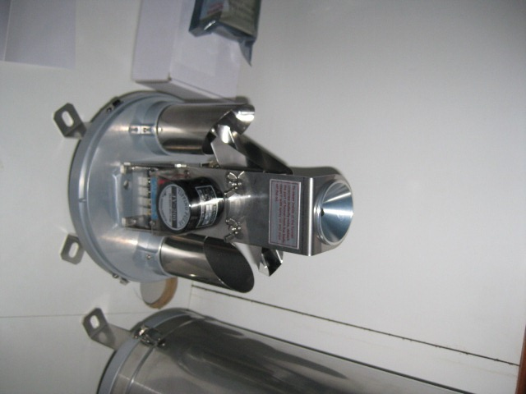
Material Inspection
In depth inspection to make sure material meets specification
Equipment that is found not to meet specification at this phase is required to be replaced by the supplier at no cost to the purchaser
Notes:
<c> A Material Inspection allows for a detailed inspection of whether proper materials are in fact used. In this case, <c> a tipping bucket rain gauge is physically inspected to make sure it meets required specifications. For instance, if metallic tipping buckets were required, this is the time that this inspection can be made. <c> If equipment is found not to meet the specification at this phase, the bidder/supplier is required to replace the equipment at no cost to the purchasing agency.

Slide 30
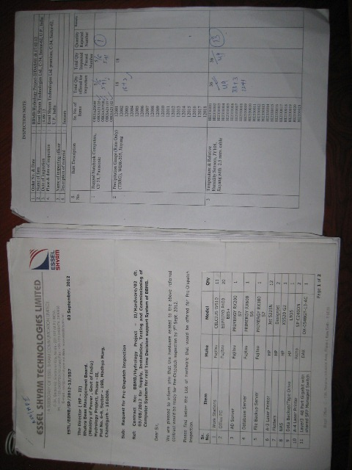
Receiving Report Inspection
Receiving report provided by Supplier
Purchaser confirms quantities versus quantities specified
Notes:
<c> Here is an example of a receiving report which is <c> provided by the supplier. This report can be used to identify the make/model and numbers of equipment being received. <c> At this stage, the purchaser confirms the quantities delivered versus the quantities specified. All equipment numbers specified must be received. Once the receiving report is confirmed, all of the boxes must be opened to confirm the make/model numbers of the equipment match that indicated on the receiving report.

Slide 31
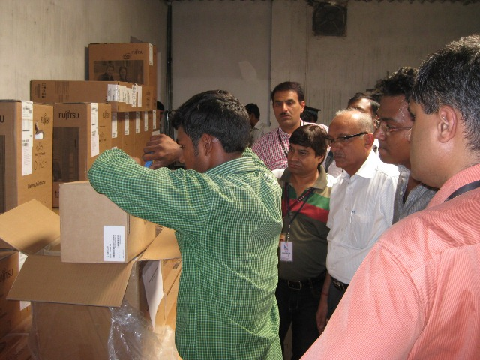
Shipment Inspection
Physical inspection of equipment
Record make, model, serial numbers, and confirm with receiving report
Determine that all equipment has been delivered before officially receiving equipment (this is always required by agencies, and a condition of payment)
Notes:
Here is a picture of a shipment inspection taking place. <c> This is a physical inspection of equipment. <c> the make, model, and numbers of equipment are compared to the receiving report, and that which was offered in the bid. The objective of this exercise is to <c> determine that all equipment as been delivered before officially receiving the equipment. This is always required by agencies and is a condition of payment. After this is completed to the satisfaction of the purchasing agencies receiving team, the equipment can be transferred to the purchasing agency.

Slide 32
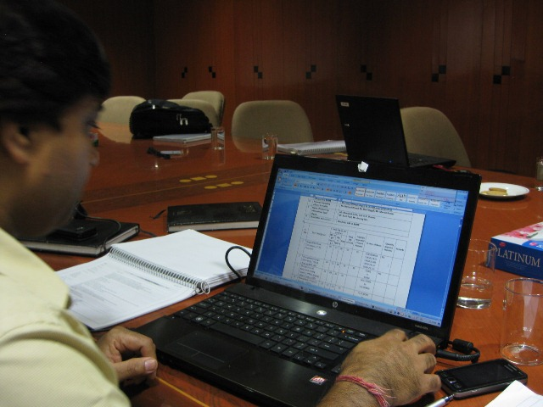
Recording Inspection Results
Record all information on a spread sheet
Later you will record where each piece of equipment is installed and keep a database tracking this equipment
Notes:
Recording Inspection Results. <c> it is important that the results of the equipment inspection be recorded. <c> A simple spread sheet can be used to record this information. <c> Later, you can record where each piece of equipment is installed, and store this in a database that can be used for asset tracking.

Slide 33
HIS Commissioning

Slide 34
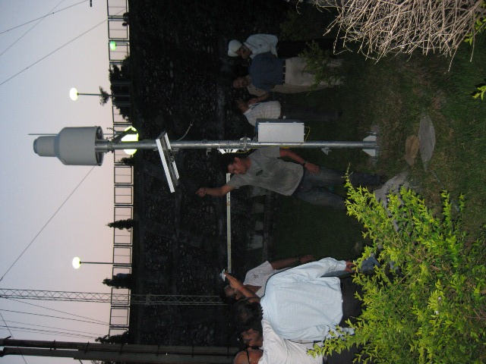
Field Inspection:
Proper and safe installation
  Appropriate River Gauge Placement
  Appropriate Rain Gauge Siting
  Appropriate Climate Station Siting
  Appropriate Ground Water Placement
Proper security
Spares in place
Notes:
An necessary component of HIS Commissioning is the Field Inspection. <c> All field sites must be inspected to make sure the stations <c> are properly installed, and where maintenance can be performed in a safe environment. Items which require specific attention are <c> appropriate river gauge placement <c> appropriate rain gauge siting <c> appropriate climate station siting, and <c> appropriate ground water installation. In addition, the sites will be inspected for <c> Proper security. <c> Finally, the field inspection will make sure the specified number of spare equipment are available.

Slide 35
Data Management
Hardware – Computers
  All hardware components in place and functioning
  UPS and Backup Power Tested
Software
  All software represent legal copy and properly licensed
  Software demonstrated to be fully functional
    Web
    Quality Control
    Visualization
    Models (if any)
  All software components specified in bid is present
  Identify which servers contain software
Notes:
The other component of a HIS system that must be inspected at the time of Commissioning is the Data Management System. Data Management is generally broken in two between hardware solutions and software solutions. <c> hardware solutions consist of computers and associated devices. <c> All hardware components must be in place and functioning. <c> UPS and backup power (if specified) must be tested. <c> The second component of Data Management is software solutions. <c> All software supplied must be a legal copy and properly licensed. <c> software solutions must be demonstrated to be fully functional. <c> The software solutions generally include <c> WEB Server software, <c> Quality Control Software, <c> Visualization software. <c> <c> all software components presented in the bid offer must be present and fully functional during HIS Commissioning. <c> At this time, it would be useful to document where each piece of software resides, for instance, on which server/workstation. This should be documented in an Operation & Maintenance Manual.

Slide 36
End to end functionality
Field Equipment Collecting Data
Information transmitted is correct (Audit)
Data transferred to Data Center in Real-time
Data Visualization Meets Specification
  Tabular
  Graphical
  Map
Data viewable on Internet/Intranet in Real-time
Notes:
End to End functionality. End to end functionality should be tested. This means that data collected in the field should be automatically transferred, and appear on the visualization tools, and in the database. Quality control software should be exercised on live data. End to end functionality starts with <c> remote station data collection, and then proceeds to <c> automatic data transmission and <c> observing the successful transfer of data to the Data Center in real-time. <c> Data Visualization software will be exercised so assure that <c> tabular <c> graphical, and <c> map display of software is operational. Also, any alarms or other capabilities that you have specified in the tender document must be present. <c> data should be viewable on the Internet/Intranet in Real-time as specified. In summary, the commissioning process must prove that the data is being correctly collected, and received, and post processing is performed according to the tender specification.

Slide 37
Problems with Improperly Commissioning, HIS
Equipment not properly collecting data
Data not representative
Installation does not follow WMO guidelines or sound measurement principles
  Rain gauge errors
  Water Level errors
Equipment Security is lacking
Incorrect equipment installation
Notes:
Problems with Improperly Commissioning an HIS. If the HIS system is improperly commissioned, this could severely constrain the usefulness of your HIS, and leave you with a much more difficult system to manage. Specifically, if the HIS system is not properly commissioned, then <c> remote stations may not be properly collecting data, and <c> information being collected may not be representative of actual conditions <c> If the installation does not follow WMO guidelines, or the guidelines prescribed in the tender document, this will lead to errors in <c> rain gauge measurement, as well as <c> water level measurements. <c> if equipment does not have the proper security, then the equipment may be tampered with, or worse, destroyed. This is why a proper commissioning exercise must be completed prior to releasing progressive payments to the Bidder/Supplier. Additionally, if all field sites are not visited during the commissioning process, it may be later discovered <c> that equipment was incorrectly installed, or the wrong equipment was installed.

Slide 38
End of
Module 6

